Slide 1

Coding@GEP
Having fun with code!
Global Engineering Platform
May 26, 2020
Notes:
This presentation is generated automatically. Do not modify it. Modify the source data and regenerate a new presentation instead.
Generated by: Mayeur, X. (Xavier) - XY56RE
Date: 13/03/2020 14:30
Data source: \\ad.ing.net\WPS\BE\p\ud\000326\XY56RE\home\My Documents\Roadmap Engine\#CM Roadmap Data.xlsx
Template: \\ad.ing.net\WPS\BE\p\ud\000326\XY56RE\home\My Documents\Roadmap Engine\#CM Roadmap Presentation.pptx
Roadmap Engine: \\ad.ing.net\WPS\BE\p\ud\000326\XY56RE\home\My Documents\Roadmap Engine\Roadmap Engine.xlsm
Engine: v2.8

Slide 2
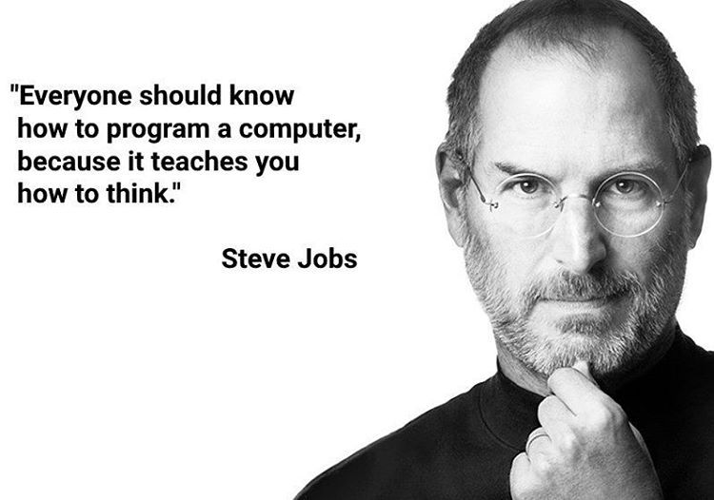

Slide 3

For who is it?
Everybody who is part of the Global Engineering Tribe can join!
This includes our direct colleagues in Poland, Romania, India and Manilla
Internals and externals
pre-requirements: Enthusiasm

Slide 4


How does it work?
For this initiative we will be using Python3.
It is one of the Top 3 most used programming languages.
And easy to learn
Subscribe to:
https://www.sololearn.com/

Slide 5

How does it work 2?
You can enter as beginner or as experienced
Every week we challenge you with a problem from the Project Euler database.
The beginner group has to finish some modules from the training before they can start with solving problems.
Please sign up with:
https://projecteuler.net/register

Slide 6

How does it work 3?
It’s not (only) about the solution, but more about the code!
Share your code on github
Not yet an account? Sign up here:
https://github.com/

Slide 7

Timelines
2 June 17:00 Handout assignment 1
9 June 17:00 Handout assignment 2
16 June 17:00 Handout assignment 3
23 June 17:00 Handout assignment 4
30 June 17:00 Handout assignment 5
8 June Send in solution 1
15 June Send in solution 2
22 June Send in solution 3
29 June Send in solution 4
6 July Send in solution 5
14 July Awards & winners

Slide 8
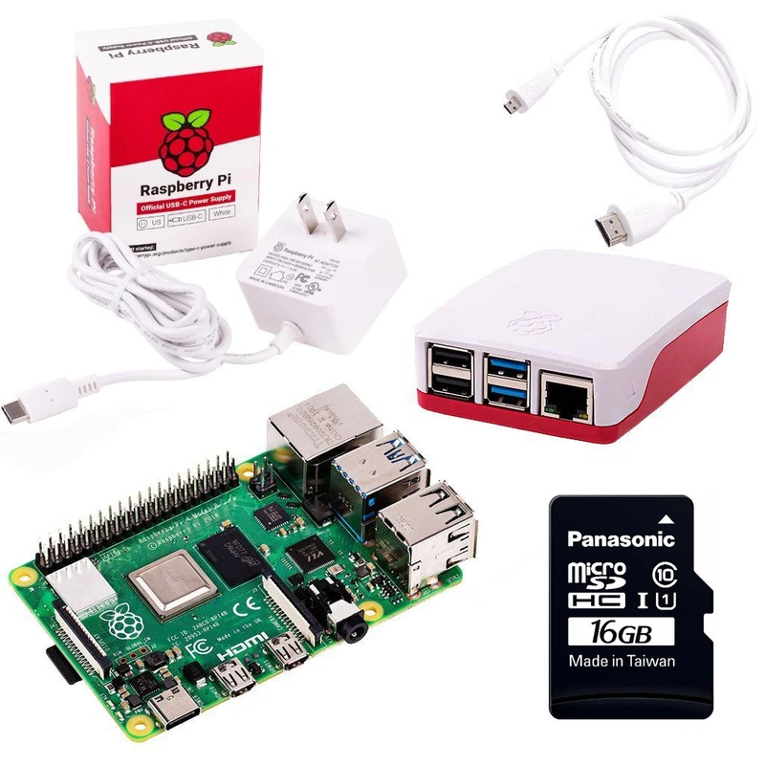
Awards & Winners
The Jury will decide who wins a
Raspberry Pi 4 starter kit
We will look at:
Clean code and Efficient algorithms
For beginners:
Make sure you get your Certificate!

Slide 9
Communication
Ask and answer questions on Mattermost:
https://mattermost.ing.net/signup_user_complete/?id=11uywssnkbdjuq79c6nyq3hrec
Every week in the Townhall we give an update
Share your Euler “friends” key (optional)
Share your GitHub code repository or SoloLearn code with Taco only

Slide 10
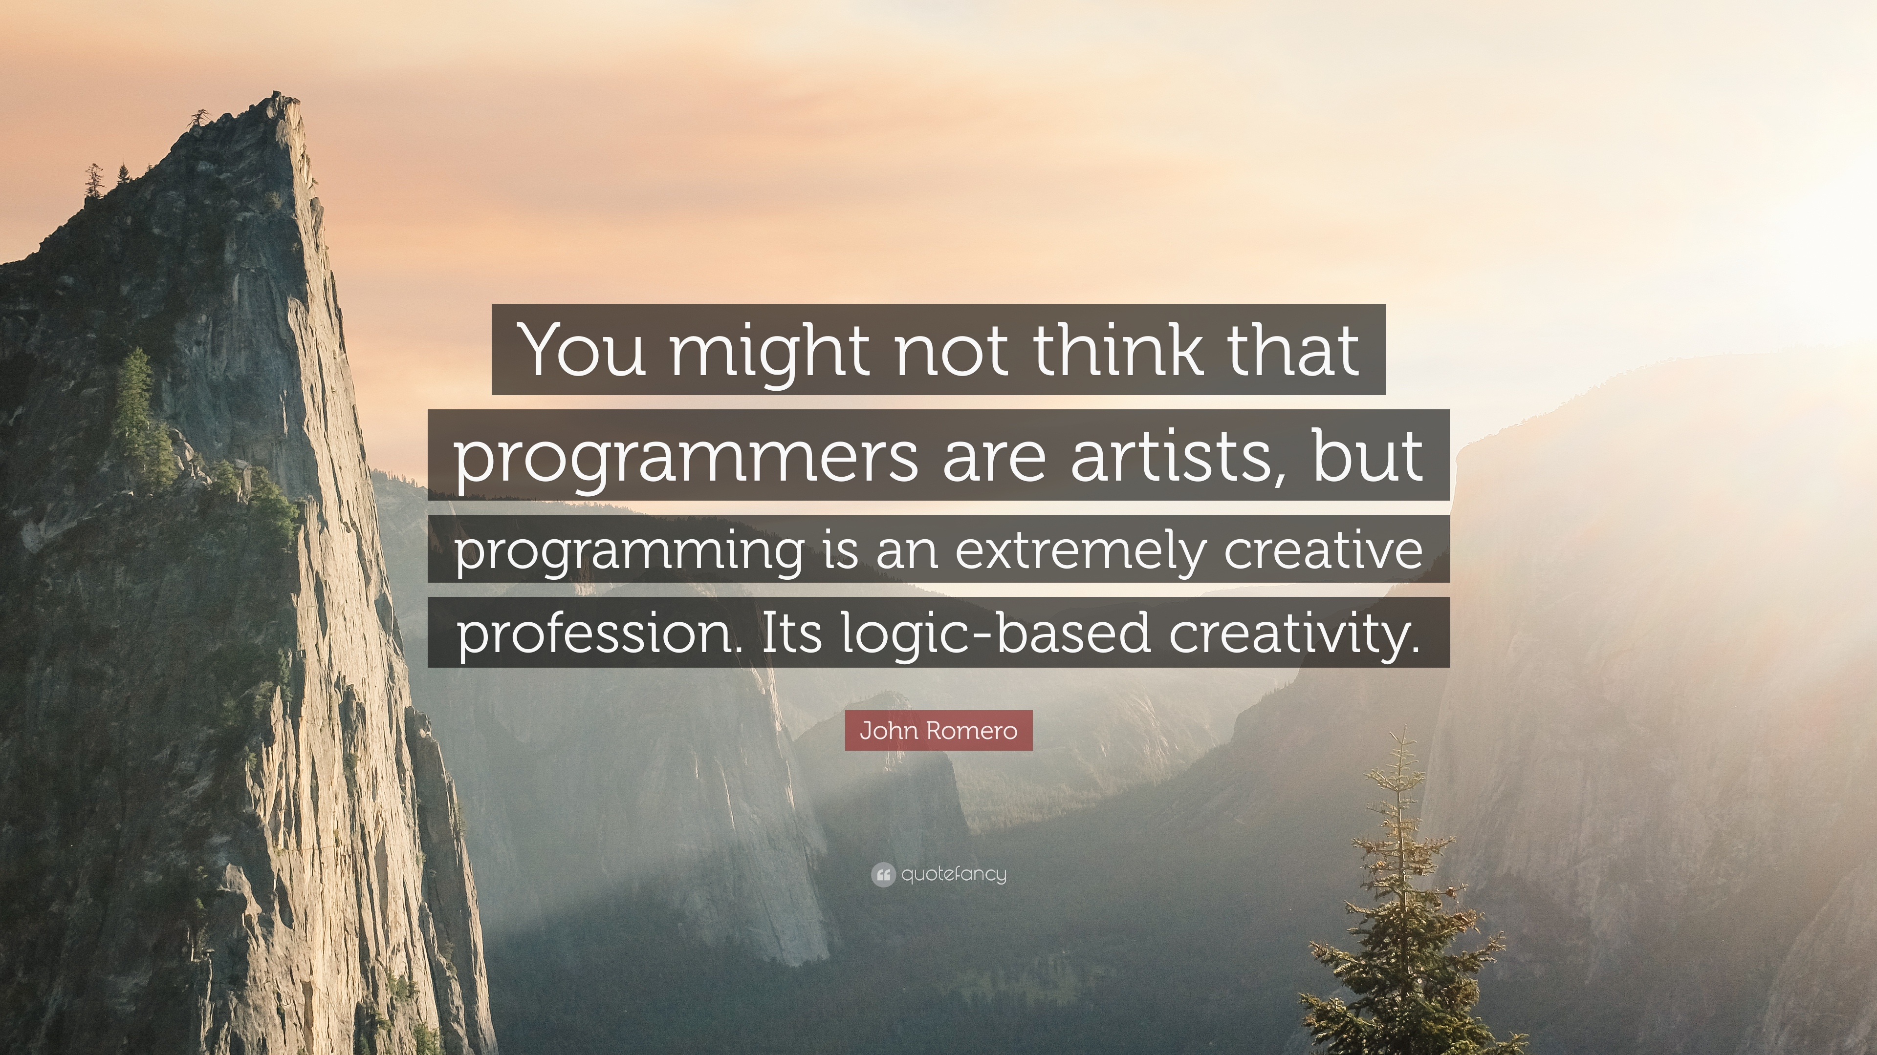

Slide 11

Setting up your environment (optional)
Download & install Python3:
https://www.python.org/downloads/
Download & install PyCharm:
https://www.jetbrains.com/pycharm/download
Download & install Git:
https://git-scm.com/downloads

Slide 12

Get to know your environment (optional)
Learn the basics of PyCharm in 10 minutes:
https://youtu.be/56bPIGf4us0
Learn Git in 15 minutes:
https://youtu.be/USjZcfj8yxE
How to push code to github in 6 minutes:
https://youtu.be/wrb7Gge9yoE

Slide 13
For beginners who like to keep things simple
Code in SoloLearn
No software installations needed
No need to learn PyCharm, Git and GitHub
Note: An IDE like PyCharm and Git offer a lot of advantages. It’s up to you!

Slide 14
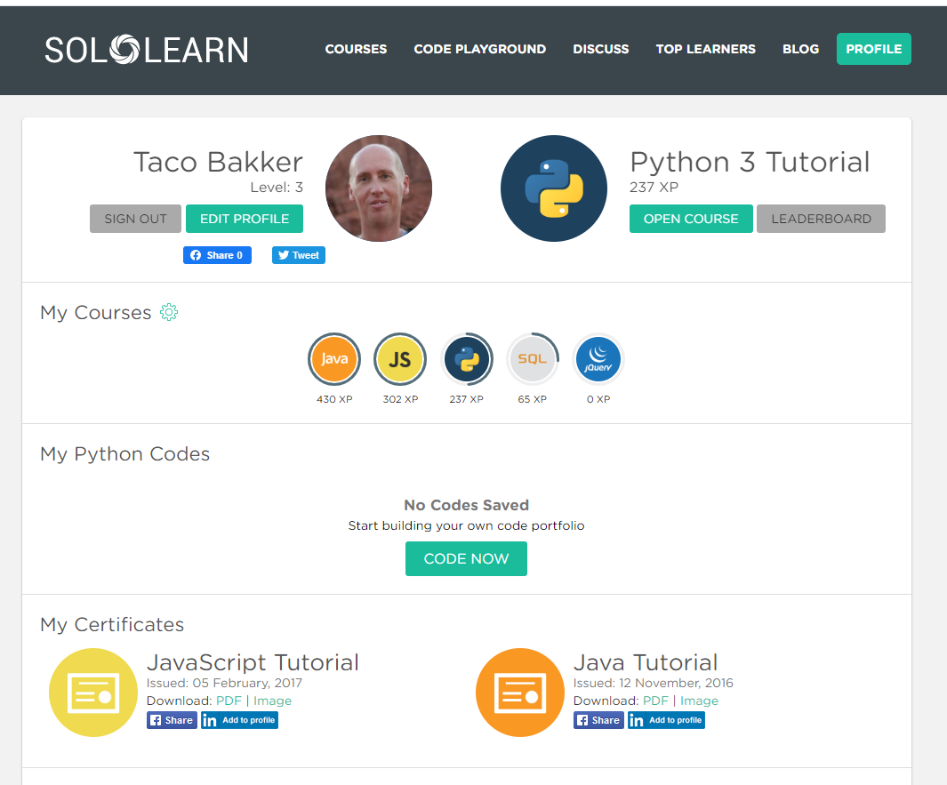

Slide 15
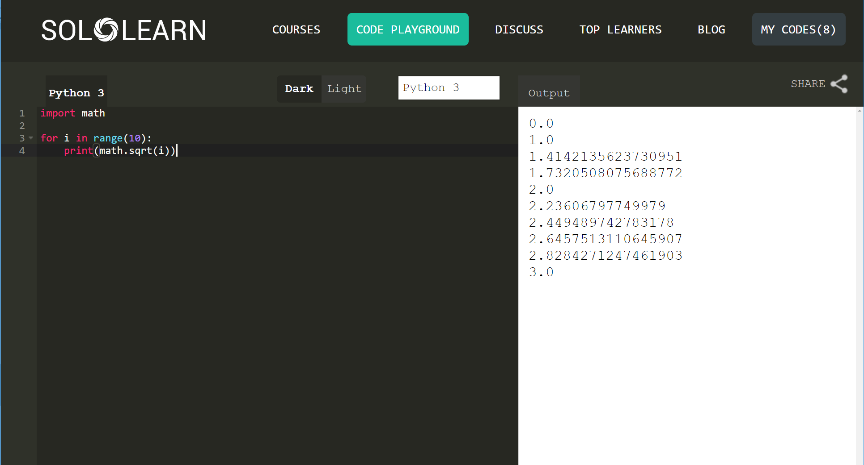
SoloLearn has a build-in Python environment where you can create, run and store code.

Slide 16
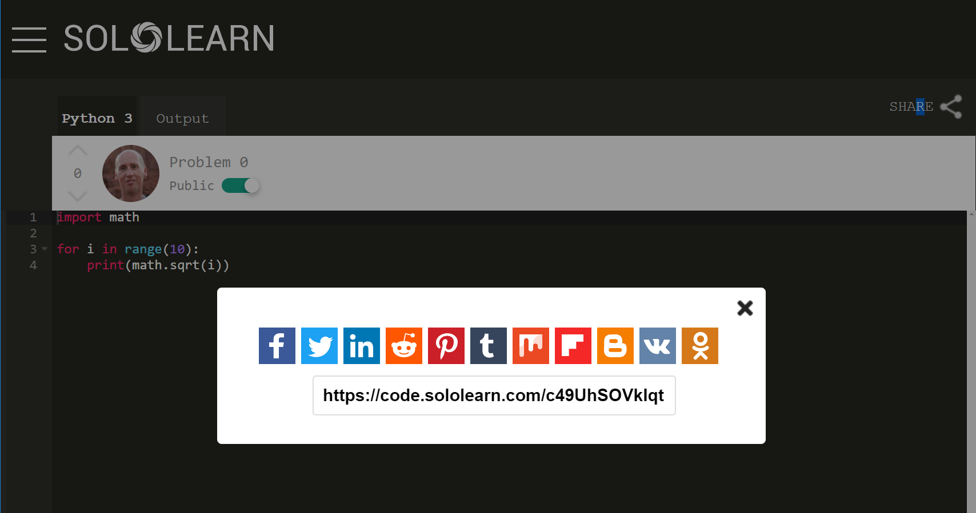

Slide 17
https://github.com/SonnyBurnett/tacobakker.git
Your github name
Repo name

